Slide 1

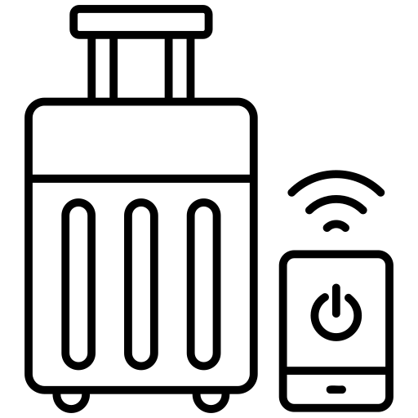
The Smart Adaptive Suitcase
Innovative Luggage for the Modern Traveler
Armando Suarez Burgos
Bronx Tech Hub’s AI Prompt
AI Project Presentation

Slide 2

What I Learned from the Fellowship
Through this fellowship, I learned that artificial intelligence is not just about building smart systems, but about solving real world problems with purpose, and ethical responsibility. I developed a deeper understanding of how to connect technology with users needs, validate ideas through market research and think like both an engineer an entrepreneur. The experience strengthened my ability to transform innovative concepts like my smart suitcase into practical. Most importantly, I learned that successful AI innovation requires vision, collaboration, and discipline execution.

Slide 3
The Travel Problem
My Solution
Airline size requirements are different (Delta, American and JetBlue 22 x 14 x 9 inches) and Spirit and Frontier 18” x 14” x 8”)
Travelers pay extra fees for oversized luggage. ( run from $35- $65)
Traditional suitcases are bulky to store
No flexibility once packed
App-Controlled movement
Expandable & Collapsible design
Secure lock & GPS tracking
Fully customizable appearance

Slide 4



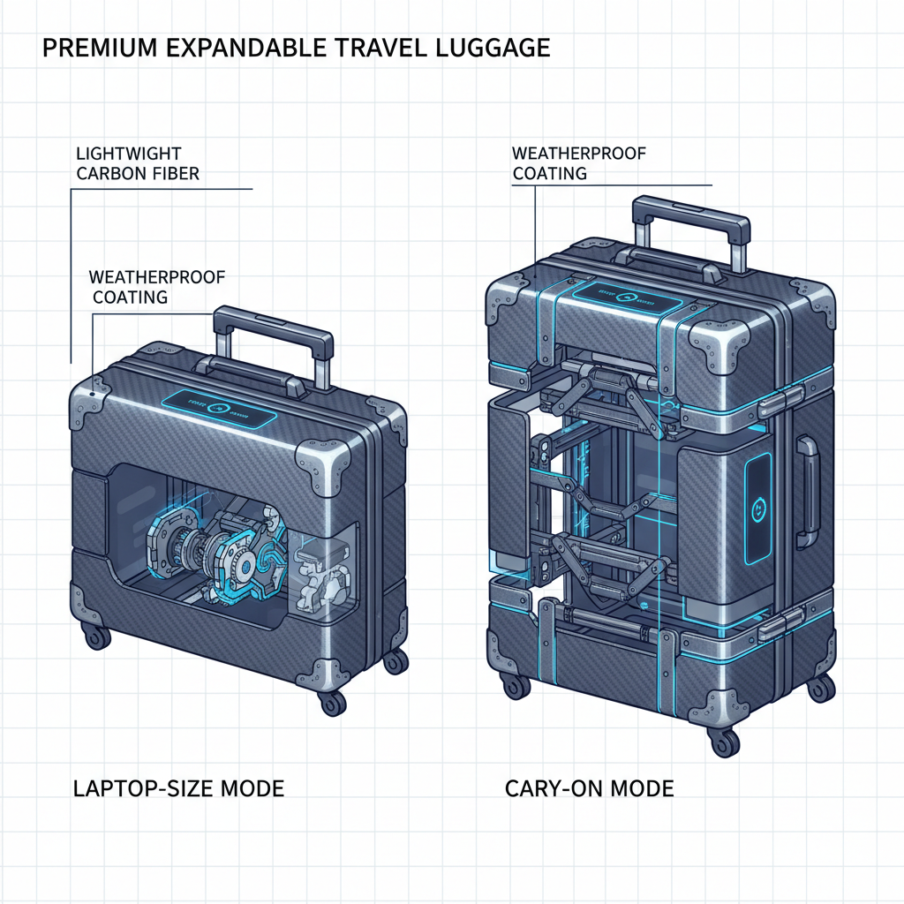
Product Feature
App-Controlled Movement
Resizable Design
GPS Tracking
Customizable Look
Folds Down to Laptop Size
https://little-lingo-lab.base44pp/

Slide 5
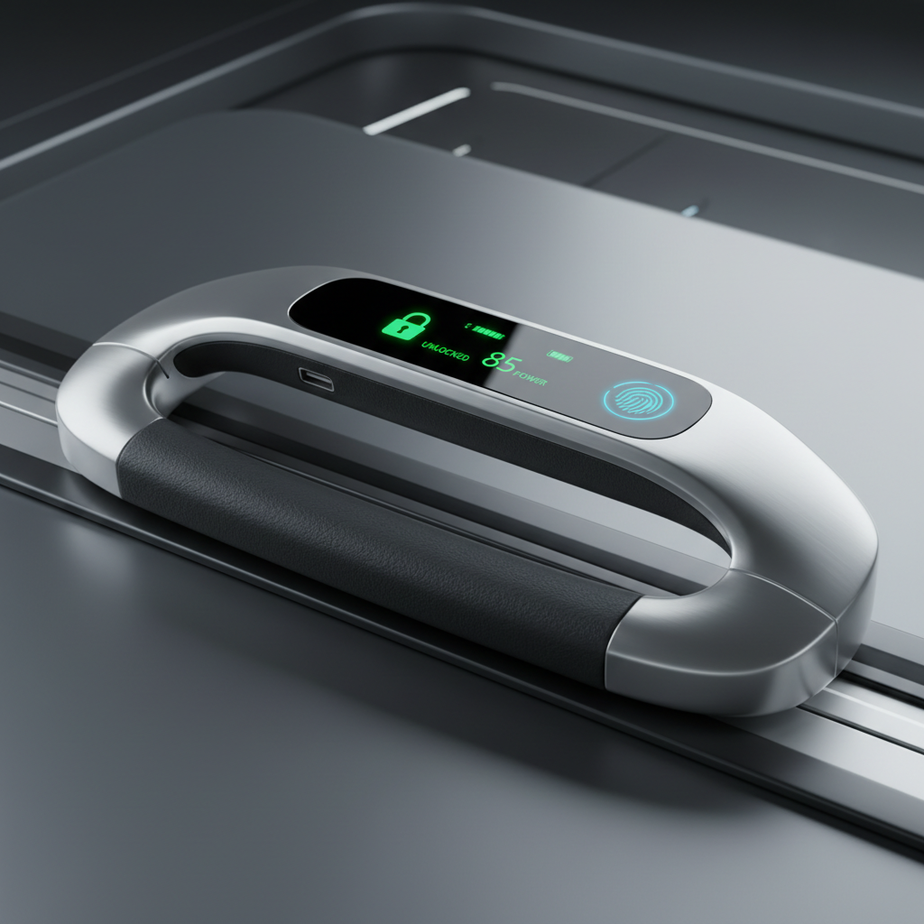
Key Benefits
Adjust to Airline Size
Limist
Easy Lock & Unlock
Real Time Location Tracking
Durable & Waterproof

